Slide 1
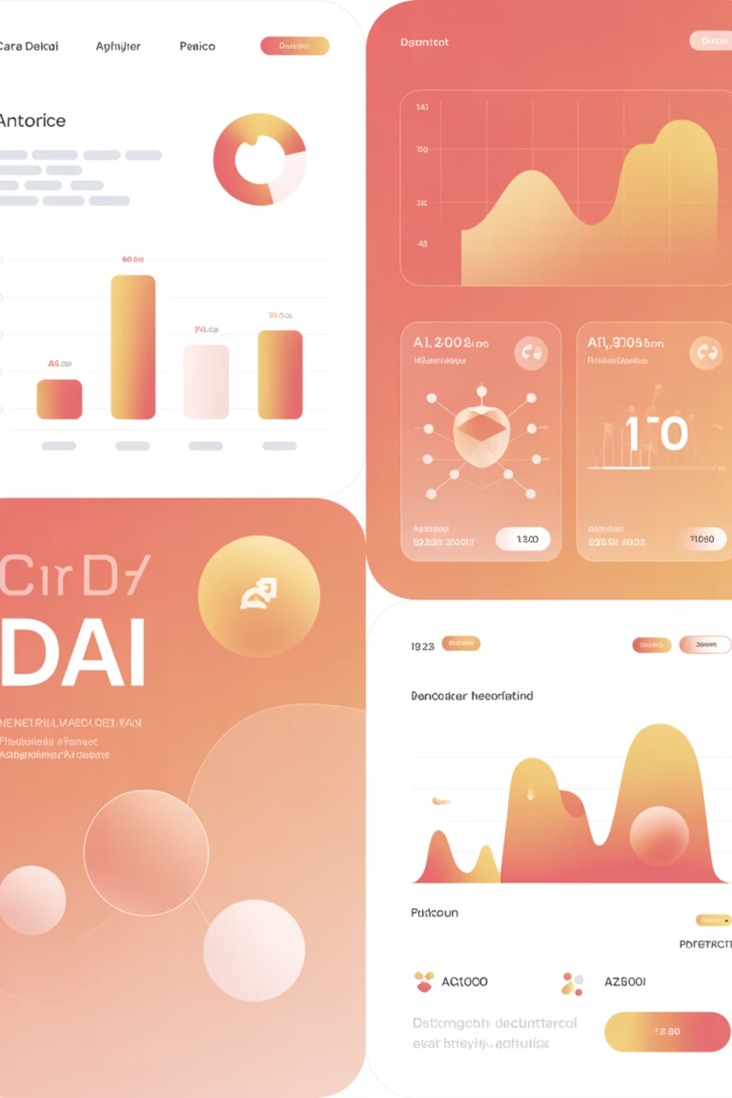
Smart Retention: AI-Powered Partner Churn Prediction
Presented By:
Akshyat Ankur Patel Yash Viren Jhaveri

Slide 2

THE CHALLENGE
The Partner Retention Crisis
Partner churn directly impacts revenue growth and ecosystem stability. Traditional reactive approaches wait until partners have already disengaged, making recovery difficult and costly.
The shift to predictive analytics transforms partner management from damage control to strategic intervention. By identifying at-risk partners early, we can allocate resources efficiently and intervene whilst relationships remain salvageable.

Slide 3


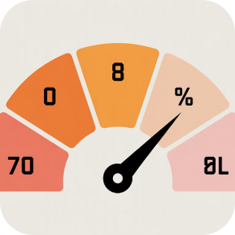
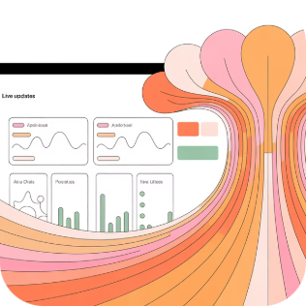
CORE TECHNOLOGY
The Churn Prediction Engine
Random Forest Classifier
Risk Probability Scoring
Continuous Monitoring
Advanced machine learning model analysing complex partner behaviour patterns across multiple dimensions simultaneously.
Each partner receives a precise risk score based on performance trends, support interactions, and engagement metrics.
Real-time data integration ensures risk assessments remain current as partner circumstances evolve.

Slide 4
Feature 1: Holistic Dashboard Overview
A unified command centre providing comprehensive visibility across your entire partner ecosystem.
Global Overview Table
Priority "At Risk" Table
Complete visibility of all partners with key performance indicators including earnings trends, activity levels, and support history at a glance.
Intelligent filtering automatically surfaces high-risk partners ranked by churn probability, enabling immediate prioritisation of retention efforts.

Slide 5

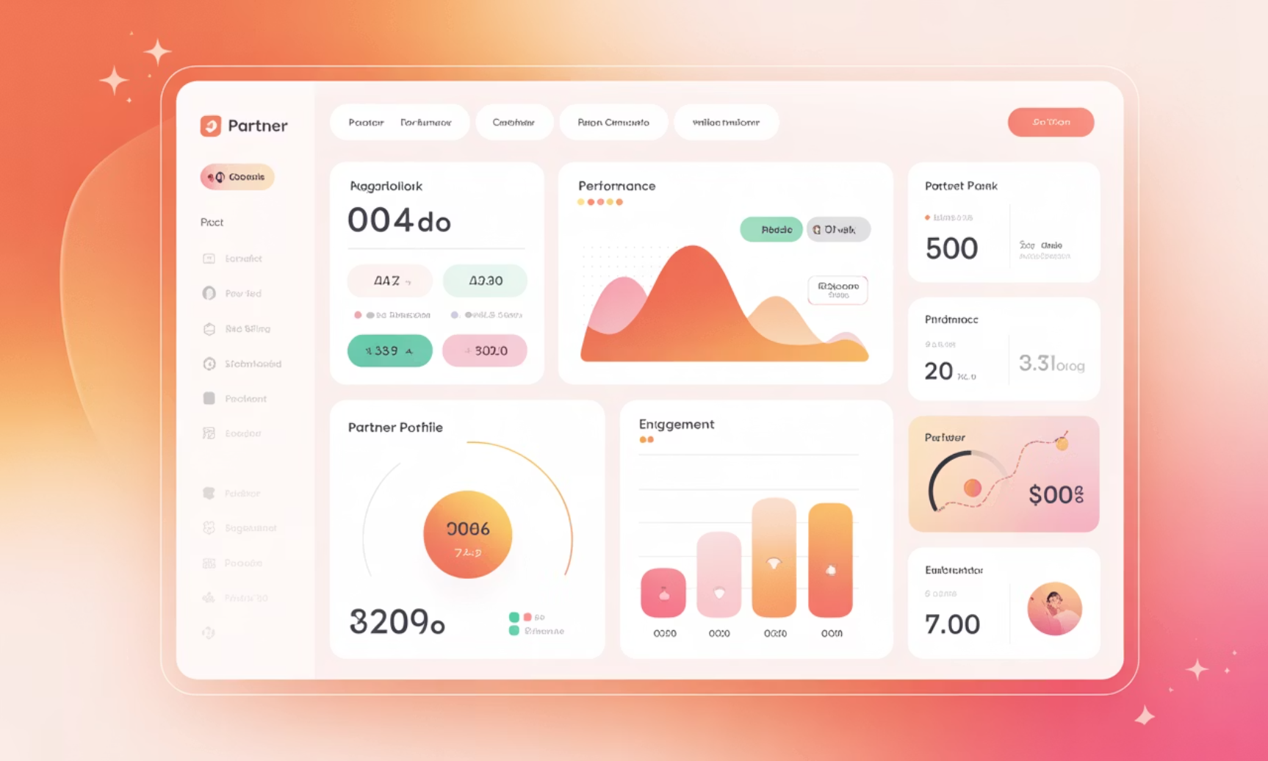
DEEP DIVE
Feature 2: Individual Partner Lookup & Risk Assessment
Instant Partner Profiling
Enter any Partner ID to unlock comprehensive risk intelligence and performance analytics in seconds.
Churn Risk Probability
Clear percentage-based scores (e.g., 85% Risk) with intuitive colour-coded status indicators distinguishing "At Risk" from "Healthy" partners.
Performance Deep Dive
Visual analytics revealing earnings trajectories, login frequency patterns, and support ticket history over time.

Slide 6




Understanding the "Why": Churn Drivers
The system doesn't merely flag risk—it diagnoses the underlying causes, empowering targeted intervention strategies.
Payout Delays
Commission Disputes
Identifies partners experiencing payment processing issues that erode trust and satisfaction.
Flags discrepancies or misunderstandings around compensation structures requiring immediate resolution.
Low Engagement
Support Friction
Detects diminishing activity levels signalling disengagement before partners completely disconnect.
Monitors ticket resolution times and satisfaction indicators revealing service quality concerns.

Slide 7
ACTION FRAMEWORK
Proactive Strategy: Recommended Actions
The dashboard transforms insights into actionable retention strategies. Each at-risk partner receives a tailored intervention roadmap based on their specific risk drivers and circumstances.
01
Re-engagement Emails
From automated re-engagement campaigns to finance escalations, the system recommends the most effective response pathway, ensuring no opportunity for retention goes unaddressed.
Personalised outreach campaigns targeting dormant partners
02
Finance Escalation
Priority routing for payment or commission issues
03
Marketing Support
Promotional resources and co-marketing opportunities
04
Account Review
Scheduled consultations with partner success teams

Slide 8

Thank You

